Slide 1
Predicting Antibiotic Resistance in Salmonella enteritidis
Rebecca Garlena

Slide 2

Project Introduction and Goal
Antibiotic resistance poses a significant public health threat, complicating the treatment of bacterial infections
Salmonella enteritidis is a major cause of foodborne illness globally, exhibiting growing resistance to antibiotics
This project aims to develop a predictive model to analyze and forecast antibiotic resistance trends in Salmonella enteritidis

Slide 3
Dataset Overview
The data used in this study is sourced from the CDC National Antimicrobial Resistance Monitoring System (NARMS)
Key features in the dataset include:
Specimen ID: Unique identifier for each isolate
Antibiotic Conclusion Columns: Indicating susceptibility (S), intermediate (I), or resistance (R)
Year and Region: Collection year and geographic region.
Age Group: Demographic information of the individual

Slide 4
Data Wrangling
Data cleaning and preparation involved:
Examination of duplicates to ensure unique isolates
Removal of irrelevant columns and those with excessive missing data
Imputation of missing values using the most common entries
Filtering the dataset to focus on data from 2003 to 2023
The AR Level for each specimen was calculated by summing all counts of resistant (R) values across the antibiotic conclusion columns.

Slide 5
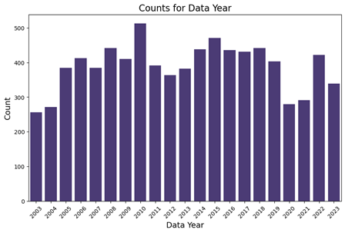
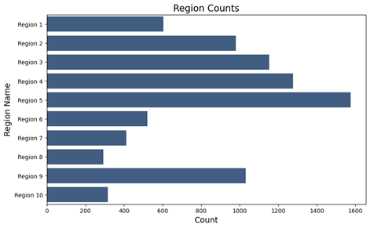
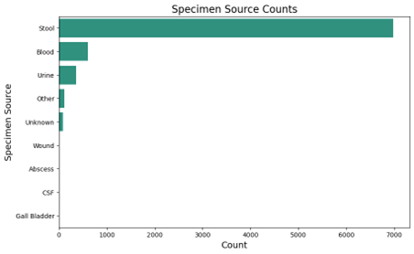
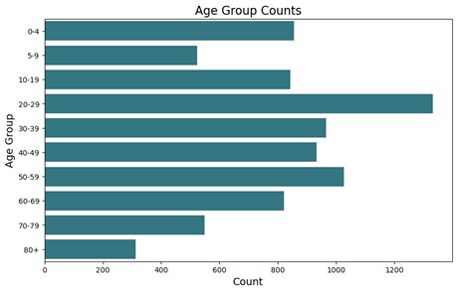
EDA: Sample Collection Trends
Variations in sample collection by year and region suggest shifts in infection rates or surveillance efforts
The dominance of stool specimens reflects clinical practices for testing gastrointestinal pathogens
Higher incidence of infections in younger populations highlights the need for targeted public health interventions

Slide 6
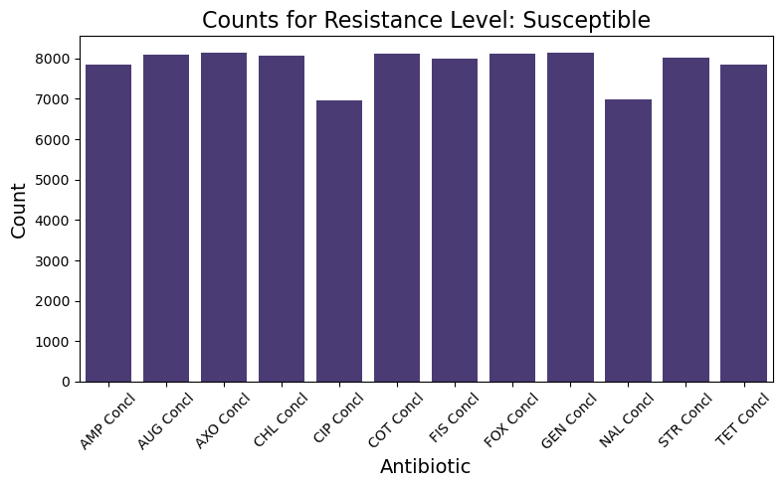
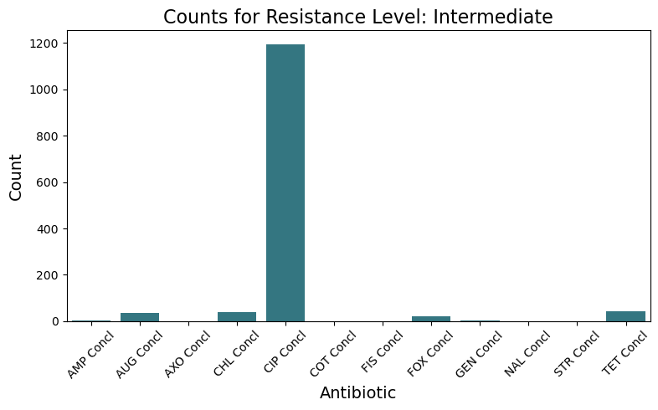
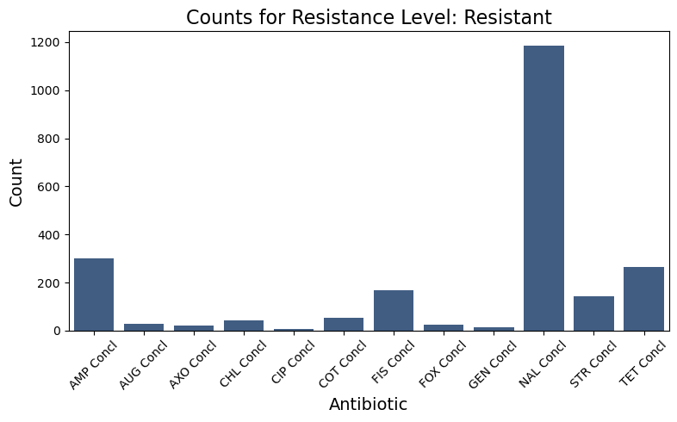
EDA: Antibiotic Susceptibility and Resistance
Prevalence of susceptible strains underscores antibiotic effectiveness
Emerging resistance noted for Ampicillin (AMP), Fosfomycin (FIS), Nalidixic Acid (NAL), Streptomycin (STR), and Tetracycline (TET)
Intermediate resistance levels observed for Ciprofloxacin (CIP)

Slide 7
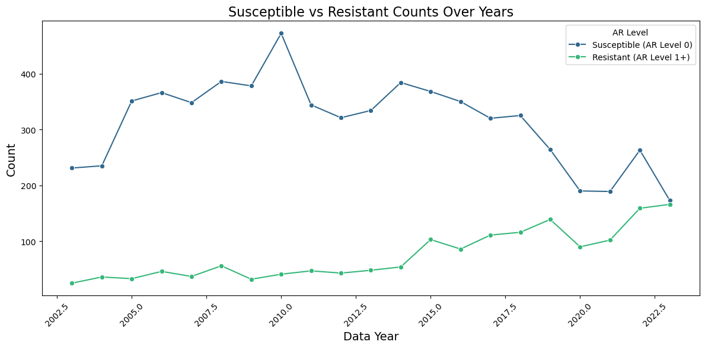
EDA: Susceptible vs. Resistant Counts Over Years
The counts of susceptible isolates (AR Level 0) consistently exceed those of resistant isolates (AR Level 1+)
However, a slight upward trend in resistant counts is observed from 2015 onward, raising concerns about increasing antibiotic resistance
Concurrently, there is a downward trend in susceptible counts, indicating a potential decline in antibiotic effectiveness

Slide 8
Modeling Approaches
The following modeling techniques were utilized:
Random Forest Regressor: Trained to predict AR Levels using antibiotic conclusion features
Exponential Smoothing: Employed to forecast future trends in antibiotic resistance
Holt’s Method: Similar to Exponential Smoothing, used for trend analysis

Slide 9
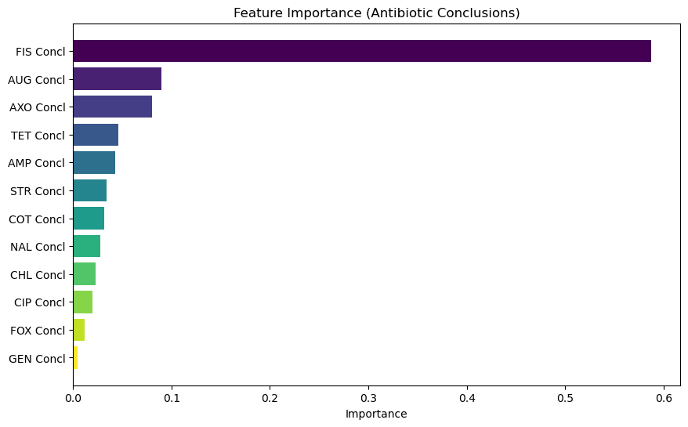
Random Forest Modeling Results
Modeling results indicate strong predictive capabilities for the Random Forest model
The Random Forest achieved a Mean Squared Error (MSE) of 0.0313 and an R-squared value of 0.9781
Feature importance analysis revealed FIS Concl as a critical factor influencing predictions

Slide 10
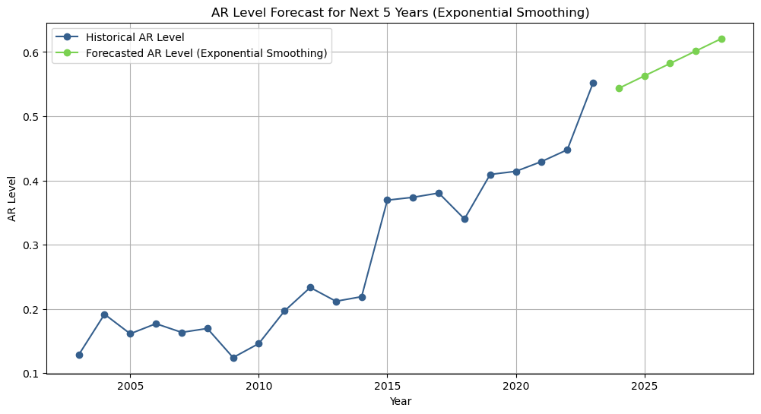
Exponential Smoothing Modeling Results
The Exponential Smoothing model forecasts indicate an upward trend in antibiotic resistance levels
This trend is projected to continue over the next five years, emphasizing the importance of ongoing monitoring and intervention efforts

Slide 11
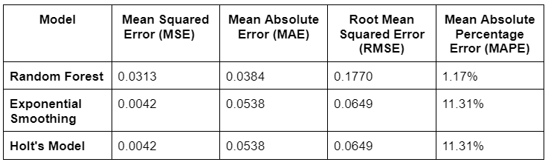
Model Metrics Overview
The Random Forest model demonstrates strong performance with low MSE and MAE.
Both Exponential Smoothing and Holt's models are effective for forecasting trends, but they have a higher MAPE

Slide 12
Conclusions
Both models provide valuable insights into predicting antibiotic resistance levels
The Random Forest model demonstrated strong predictive capabilities
The Exponential Smoothing model provides valuable forecasts, indicating an upward trend in antibiotic resistance levels over the next five years
This trend stresses the importance of continuous monitoring and proactive public health strategies to mitigate the rising threat of antibiotic resistance

Slide 13
Future Directions
Future research could focus on:
Integrating additional data attributes, including geographical and demographic factors, as well as information on food outbreaks and salmonella-related hospitalizations.
Continuous validation of models with new data to ensure adaptability to evolving resistance patterns
Exploring advanced algorithms to enhance prediction accuracy and robustness
Monitoring long-term trends beyond 2028 to inform and guide public health strategies effectively

